Slide 1
Annual Interagency Accessibility Forum
Unlocking the Power of Accessibility
October 11-13, 2022
Creating Accessible PDF Forms
Regina A. Wendling, Government Information Specialist

Slide 2
Approaching Forms
Choose the approach that works best for your situation
Considerations
Are you working with the original source document?
Has the PDF been tagged and was there a lot of remediation work done?
Are the form fields well-defined?
Is it best to add form fields, then tag or add form fields to the tagged PDF
Options
Auto detect the form fields before tagging (may require less remediation of <Form> tags in the Tag Tree but will require fixing the other types of tags, as necessary)
Auto detect the form fields after tagging (always requires fixing <Form> tags in the Tag Tree but not other types of tags)
Manually add the form fields (requires the most work)
Regardless of approach, use the Prepare Form tool in Tools pane

Slide 3
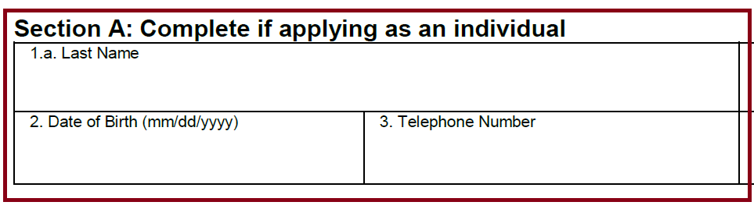
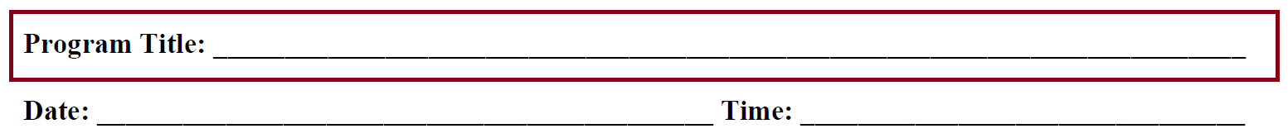

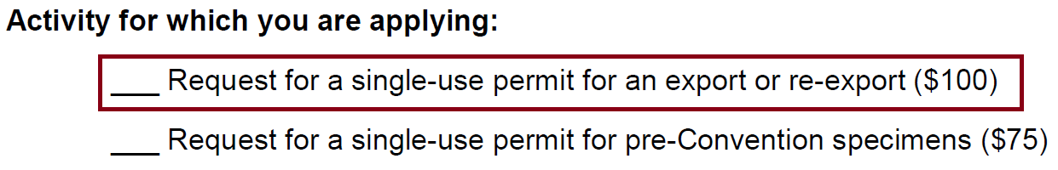
Forms Design
Clearly identify Form Fields (good examples)
Radio buttons need to be circles (bad examples)
Radio buttons (good examples)
In general, don’t use tables for layout; however, they may be necessary for consistency between forms

Slide 4
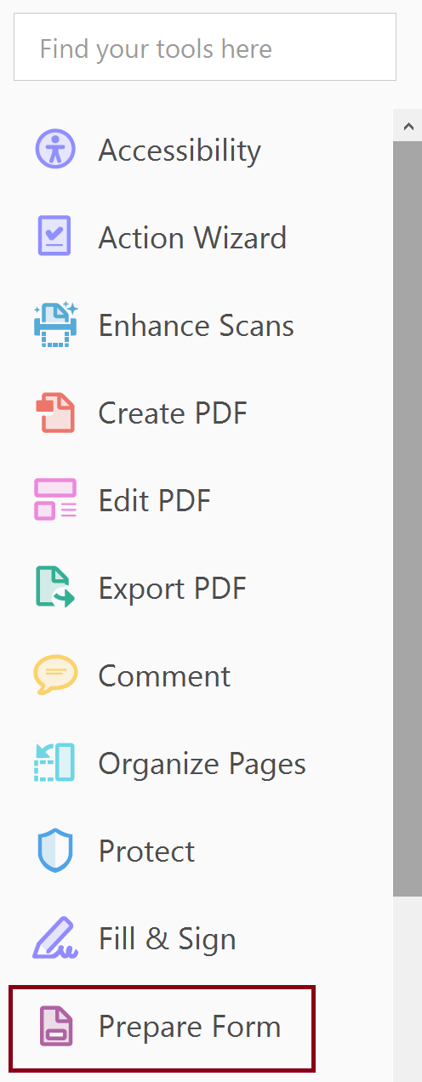
Prepare Form Tool
Added by default to the Tools pane

Slide 5
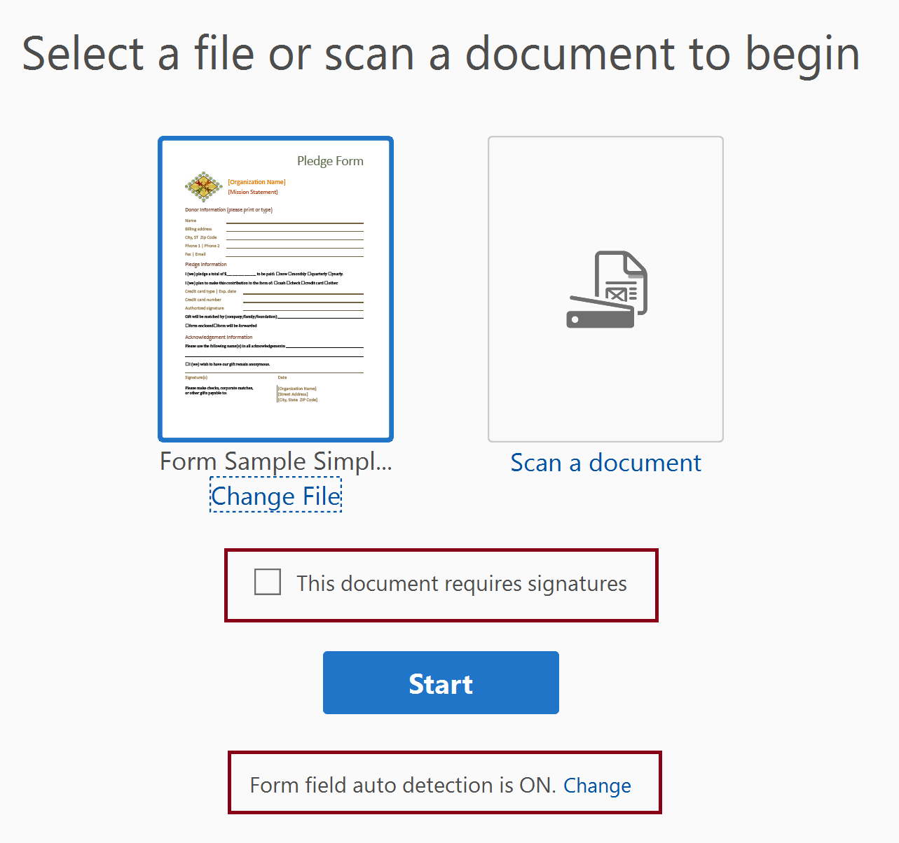
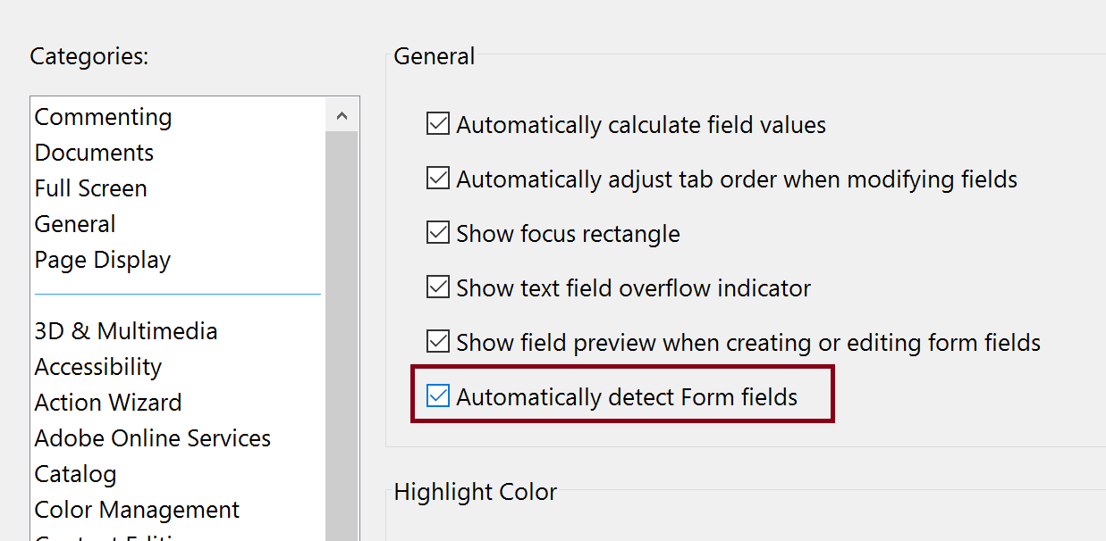
Select a Form
Choose document, if you open the document in Acrobat first it is a simple step
Do not check “This document requires signatures,” signature field applied regardless
Some functionality missing in Properties dialog (a bug?)
Choose whether to auto-generate form fields or not

Slide 6
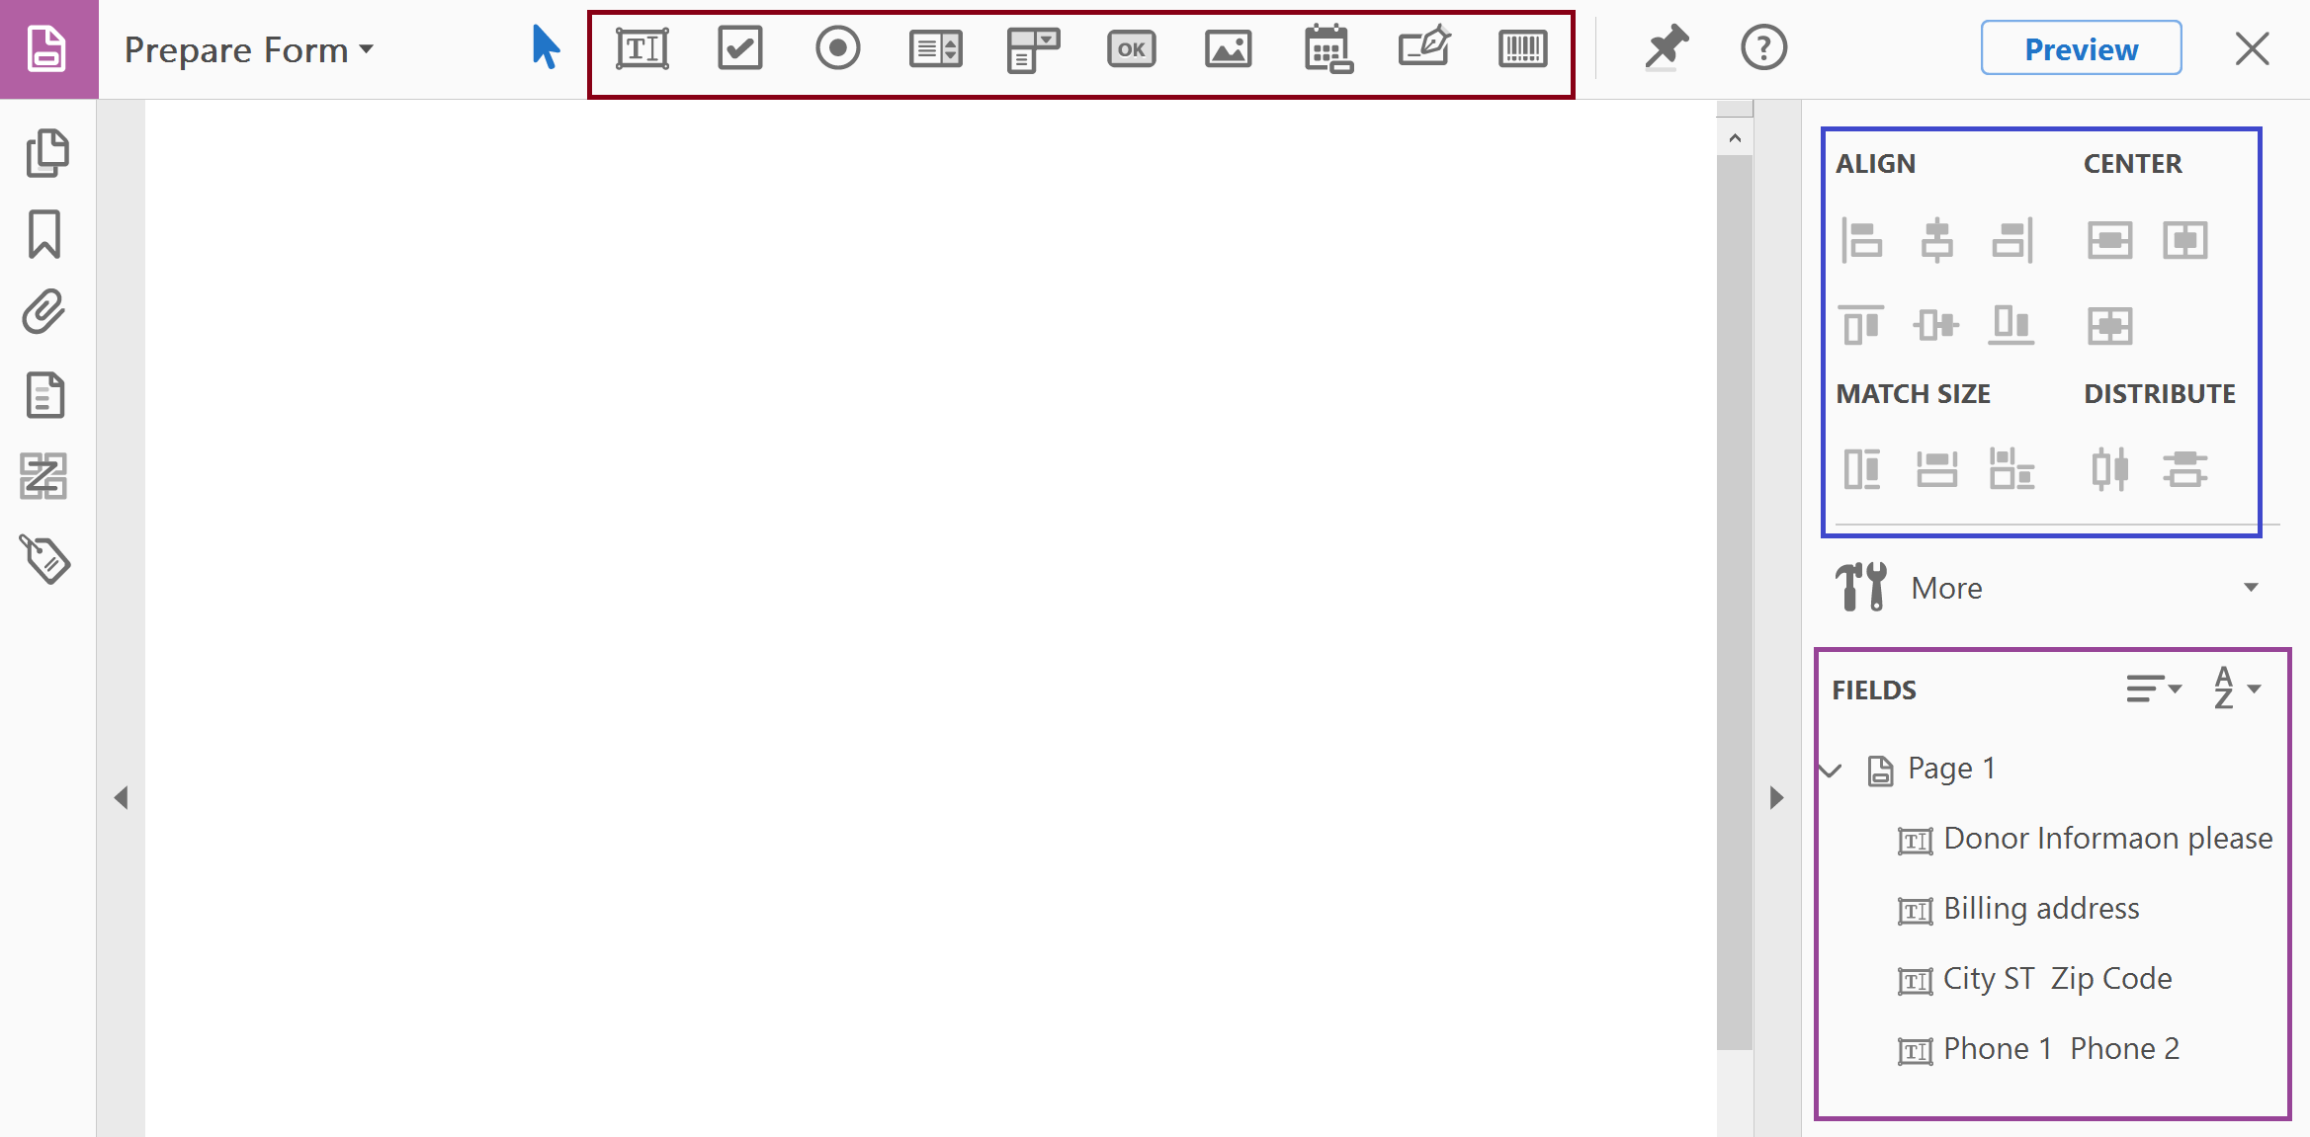
Layout of the Prepare Form Tool Functions
Manually Add Form Fields
Position Form Fields
Set Tab Order

Slide 7
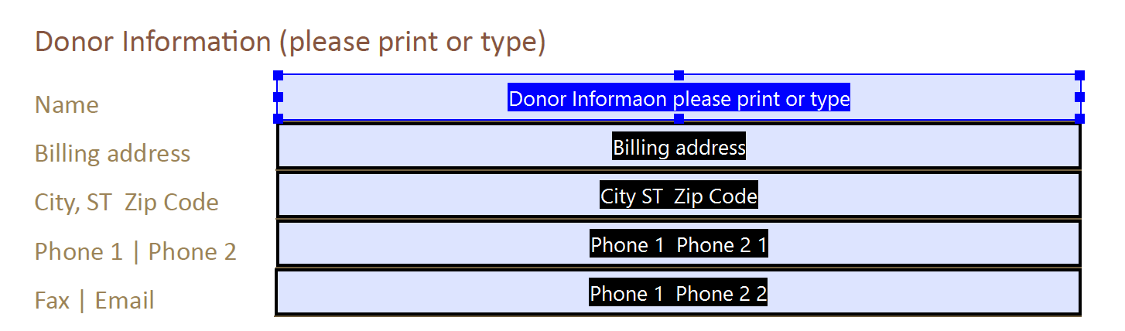
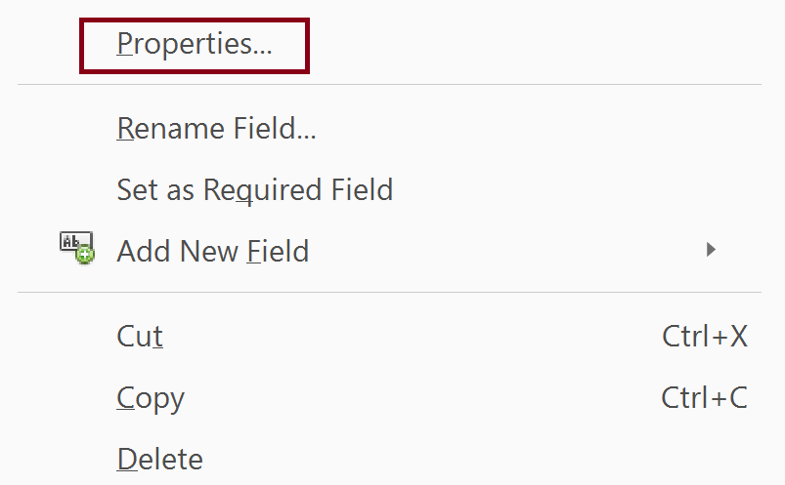
Accessing the Form Field Properties
Select Form Field
Right-Click and Select Properties

Slide 8
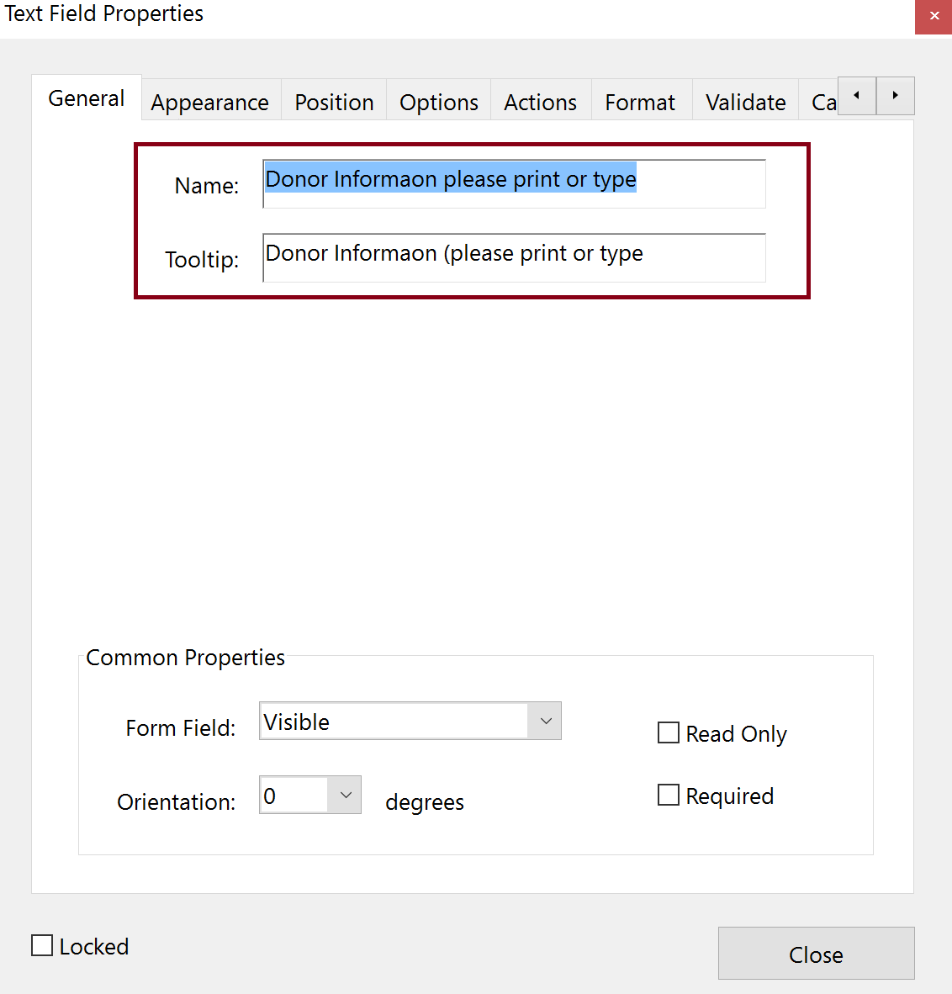
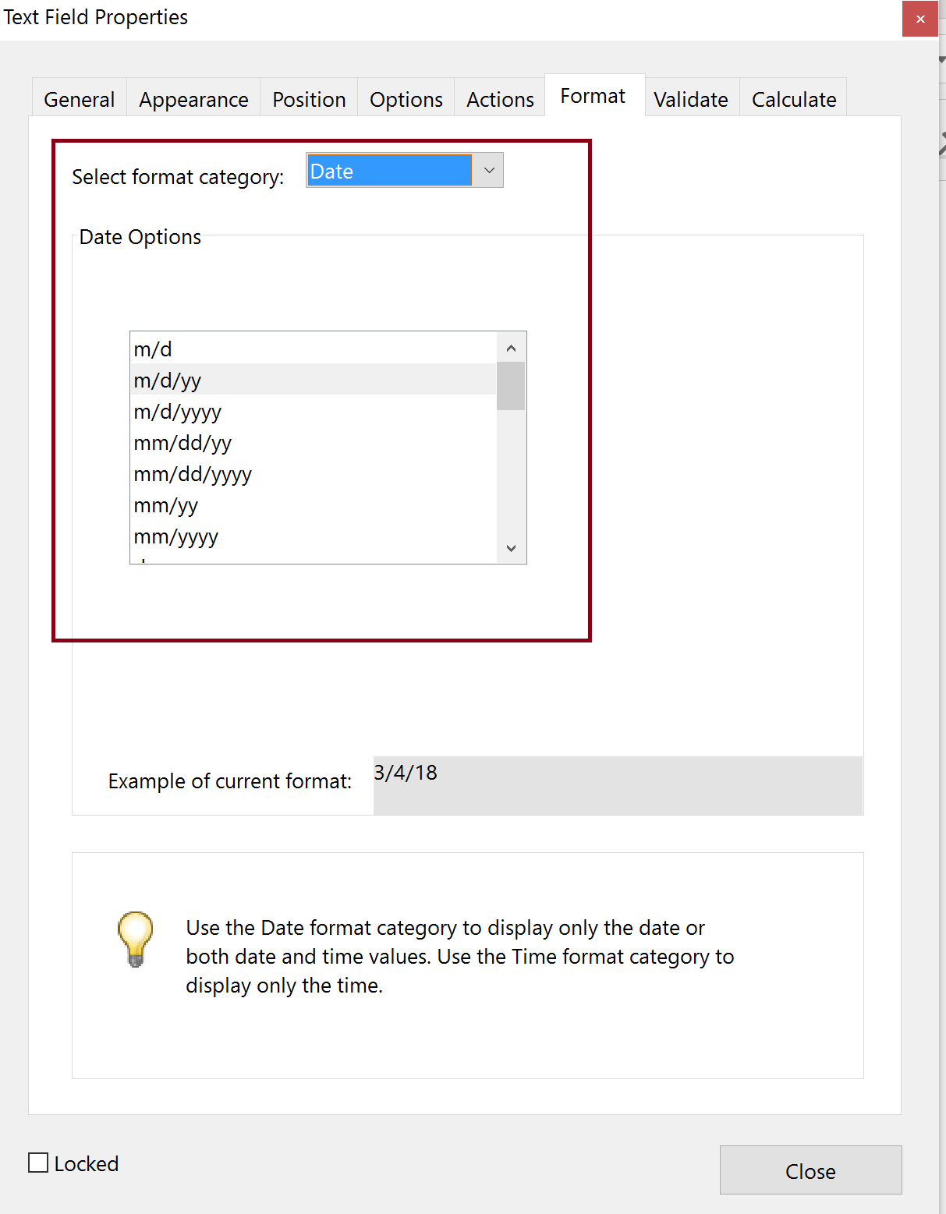
Key Field Properties

Slide 9
Creating Form Fields in the Source Document
Use the appropriate tools to add forms control
e.g., Word – Developer Tool (addition to the Ribbon)
OR
Use the appropriate shapes
e.g., Word – Insert the circle shapes for radio buttons

Slide 10
Auto Detection of PDF Form Fields

Slide 11
Steps for Adding Form Fields with Auto Detection
Run “Prepare Form”
Fix form fields properties (name and tooltip)
Check other properties
Add format to date field
Fix radio buttons

Slide 12
Getting Started with Auto Detection of Form Fields
Do not check “This document requires signatures”
Signature field applied regardless
Some functionality missing (a bug?)
Set “Form field auto detection” to On

Slide 13
Finalizing the Form

Slide 14
Fixing Form Field Properties

Slide 15
Steps to Finalize the Form
Verify and fix tab order
Test the form
Preview the form
Verify entering in data in the fields
Create Form tags or Auto-tag the Form and fix the Tag Tree

Slide 16
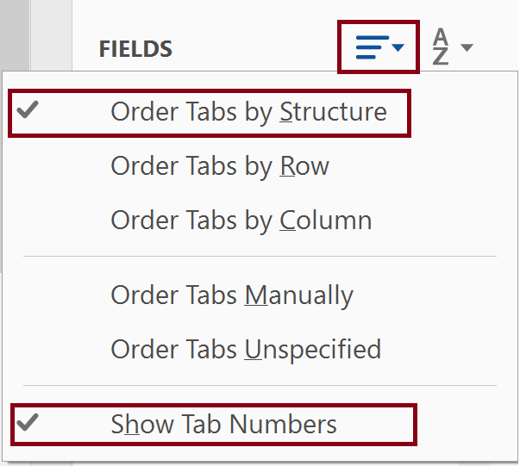
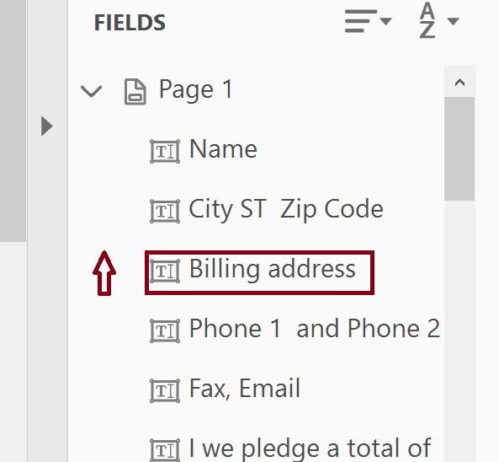
Verify and Fix the Tab Order
Enable “Show Tab Numbers”
Set the Tab order by dragging up and down

Slide 17
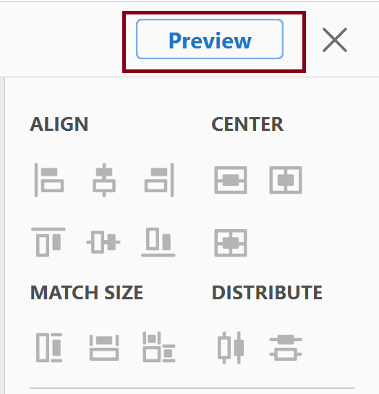
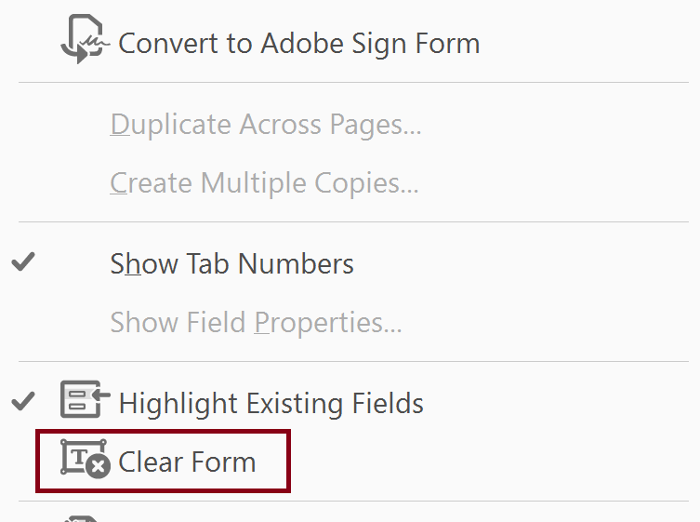

Testing the Form
Select Preview (toggles back to Edit)
Clear the form after entering data in the form fields

Slide 18
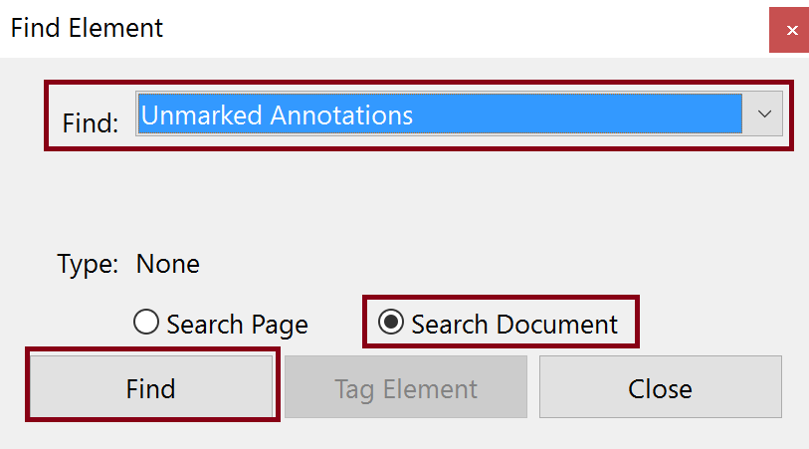
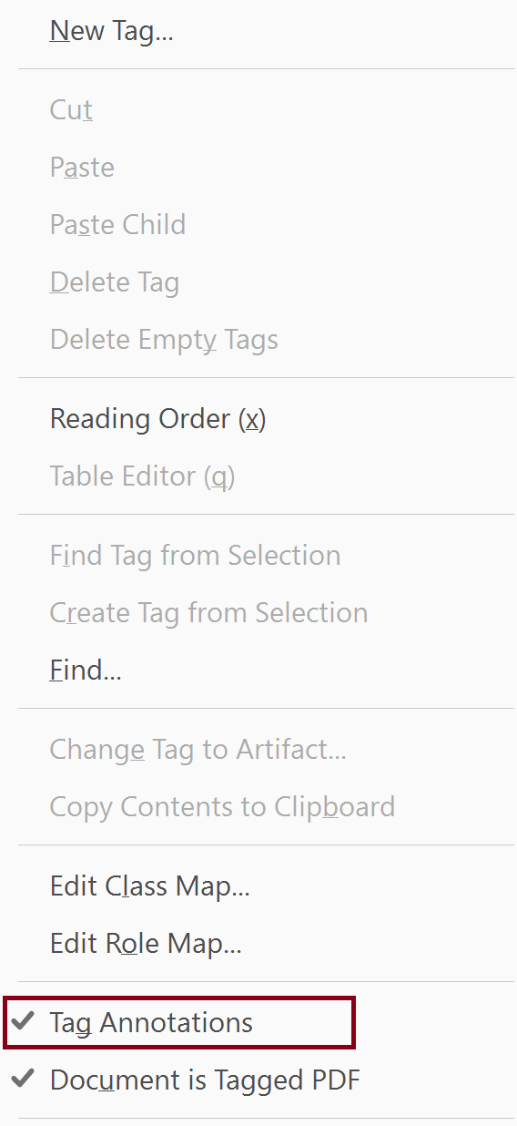
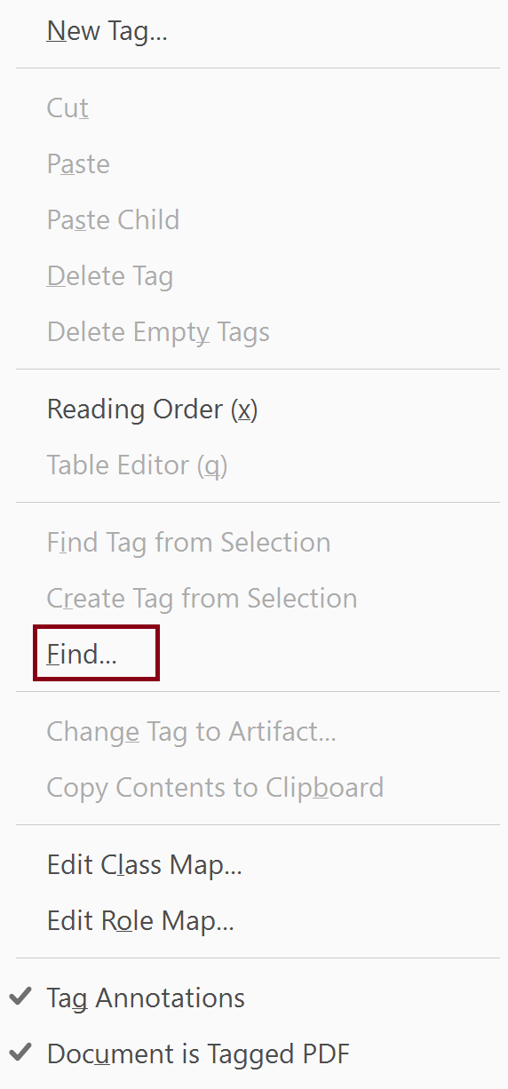
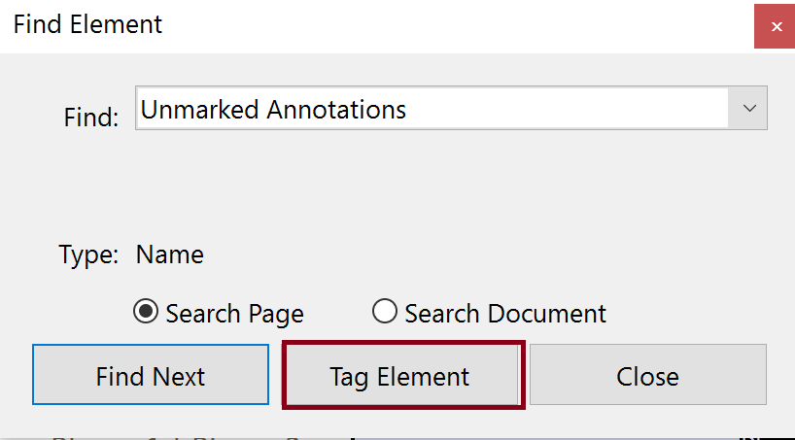
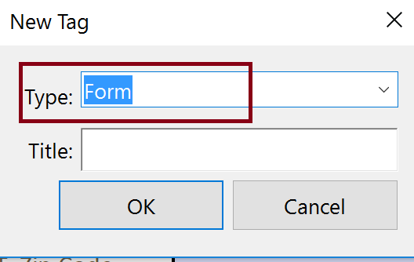
Manually Adding Form Fields to the Tag Tree
Steps
Place focus on “root” Tag
Tag Annotations
Find Unmarked Annotations
Tag Element
Set Tag Type to Form

Slide 19
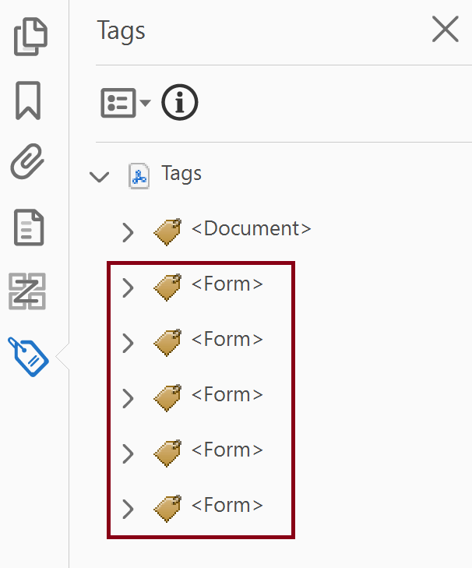
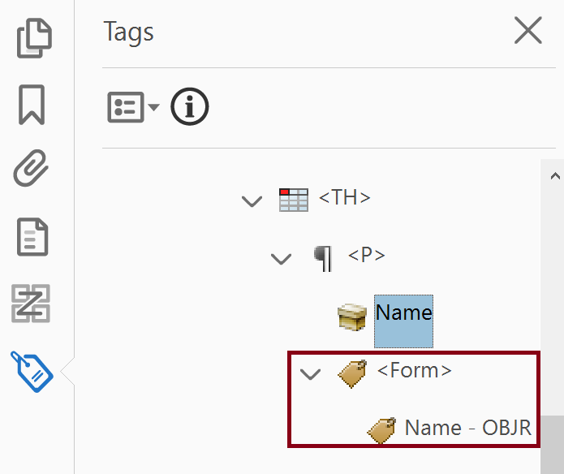
Fix Tag Tree
Form fields appear at the bottom of the Tag Tree
Move <Form> tag to the correct place in the Tag Tree as a peer (sibling) of the <P> tag content

Slide 20
Manual Creation of Form Fields

Slide 21
Adding Form Field Manually
When to manually add form fields
Creating a form from scratch
Adding/fixing form fields where form fields were auto detected
Steps
Prepare Form
Manually place form fields
Complete process for creating and finalizing forms in auto detect process except for tagging
Tag form fields manually
NOTE: Form fields will appear at the end of the Tag Tree and need to be moved

Slide 22
Multiple Form Field Options
Manually Add Form Fields
Common Fields
Text
Checkbox
Radio Button
Lists
Calendar
Signature
Position Form Fields
Set Tab Order

Slide 23
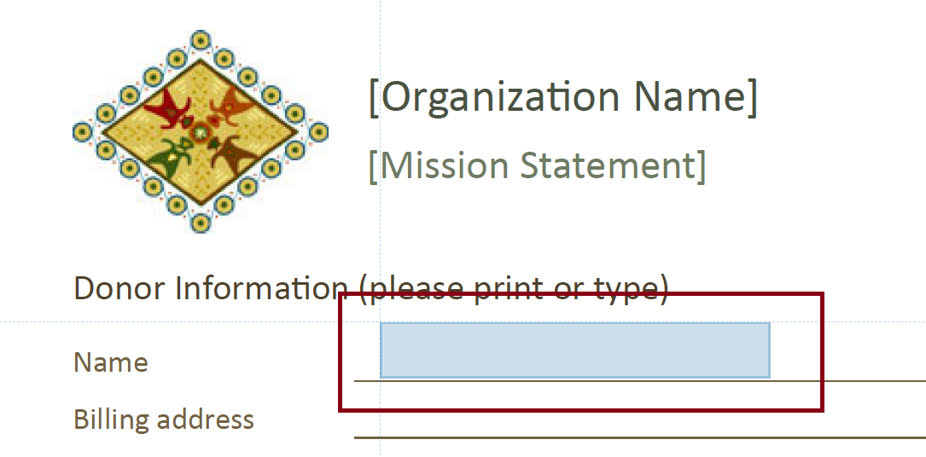
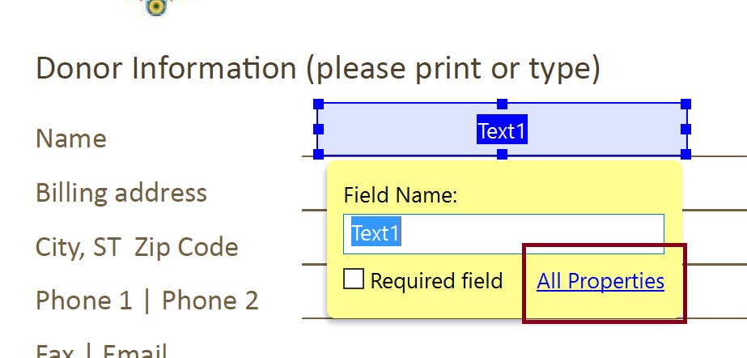
Add a Form Field (Text)
Select form field type (Text)
Drag/Drop form field in place and edit properties

Slide 24
“Special” Form Fields

Slide 25
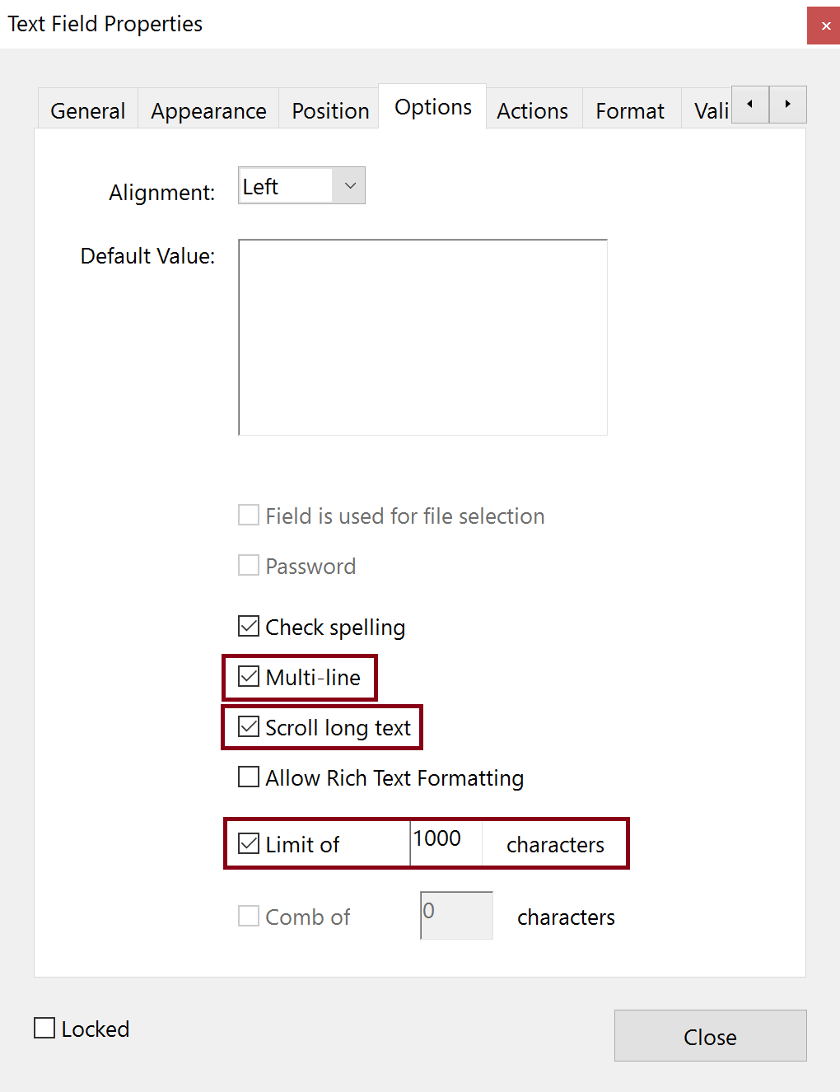
Multi-Line Text Box
Regular Text field
Size to space for text
Go to Text Field Properties > Options > Multi-line
Scroll long text
Limit of “x” characters
Notes:
Characters, not words
500 words is approximately 3,000 characters
Spaces count as characters
Even if visually there are multiple lines only create one text box

Slide 26
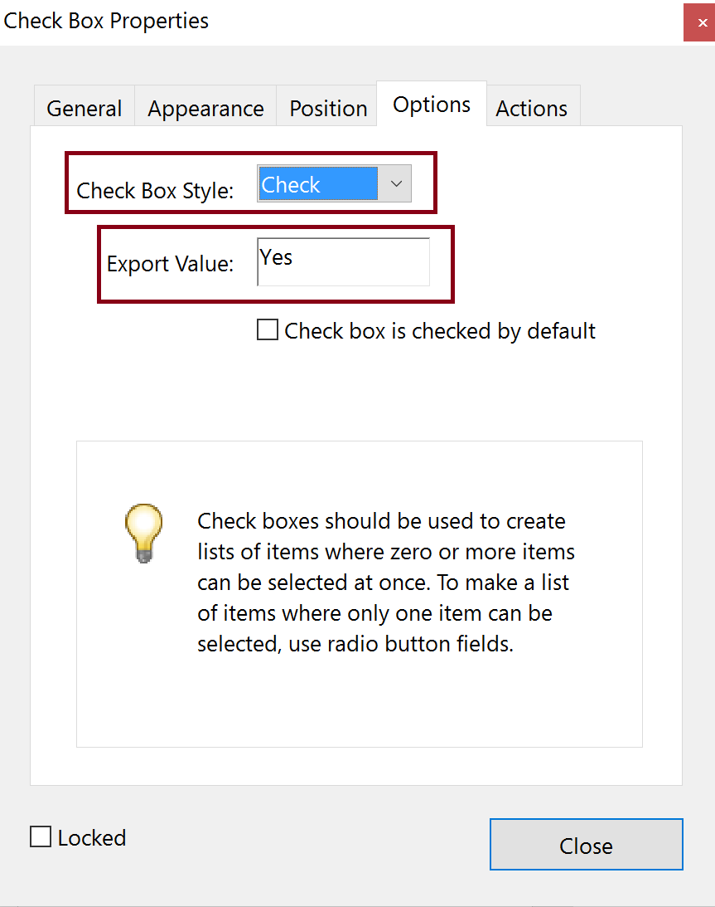
Check Box
Select Check Box
Select “Pin” to create multiple check boxes
Set Name and Tooltip
Set Options
Check Box Style
Export Value

Slide 27
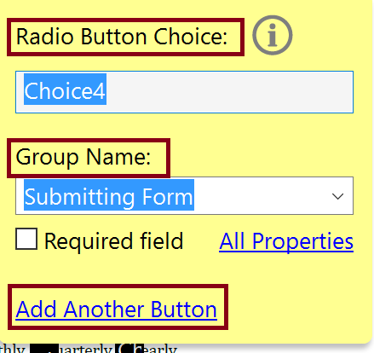
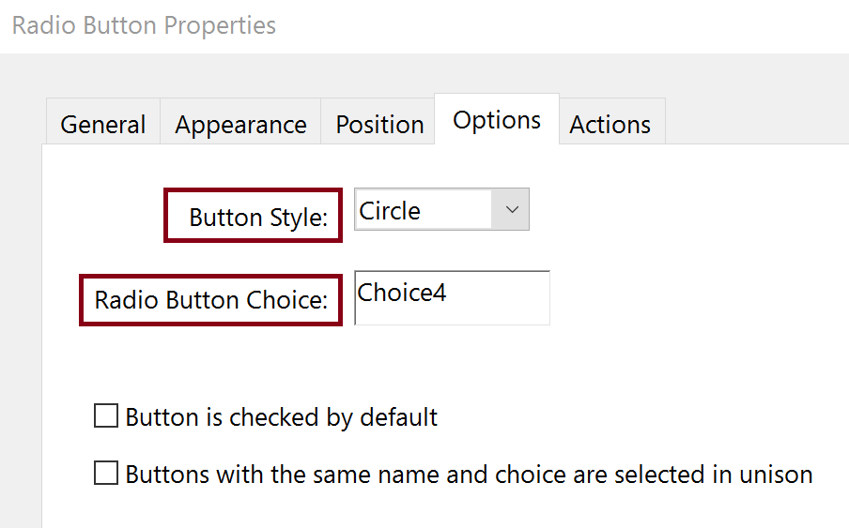
Radio Button
Select Radio Button
Create Choice – Unique to the radio button
Add Group Name – Common to the set of radio buttons (also the Name in the properties)
Add Another Button – Until all buttons are created
Select All Properties
Set Tooltip
Set Options
Button Style
Verify Radio Button Choice

Slide 28
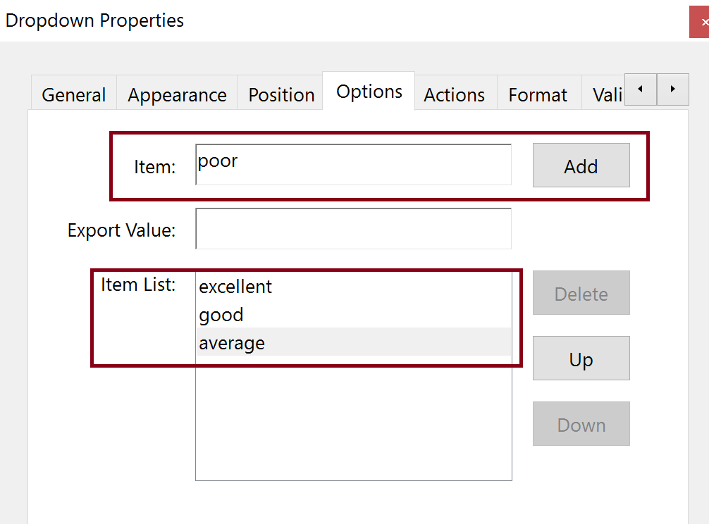
Dropdown List Box
Select Dropdown List
Set Name and Tooltip
Set Options
Add Items to select Item List
Export Value

Slide 29
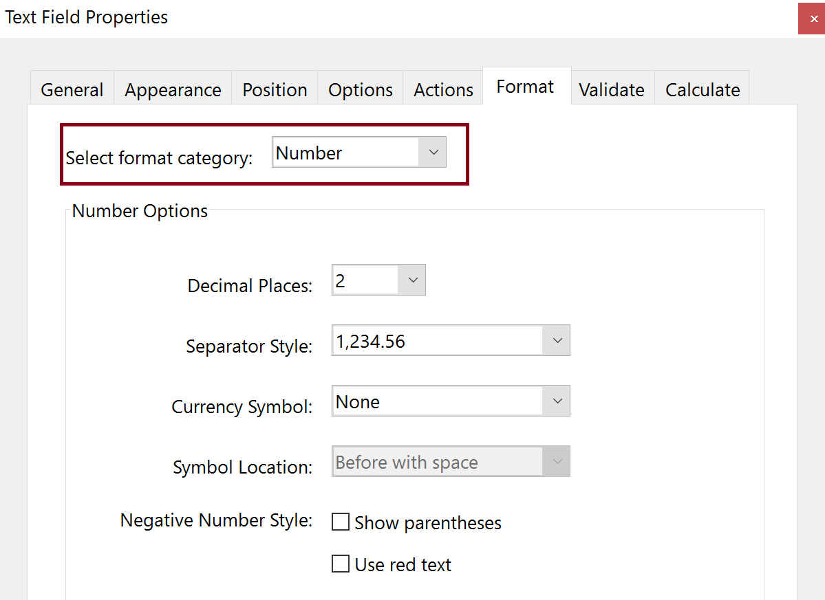
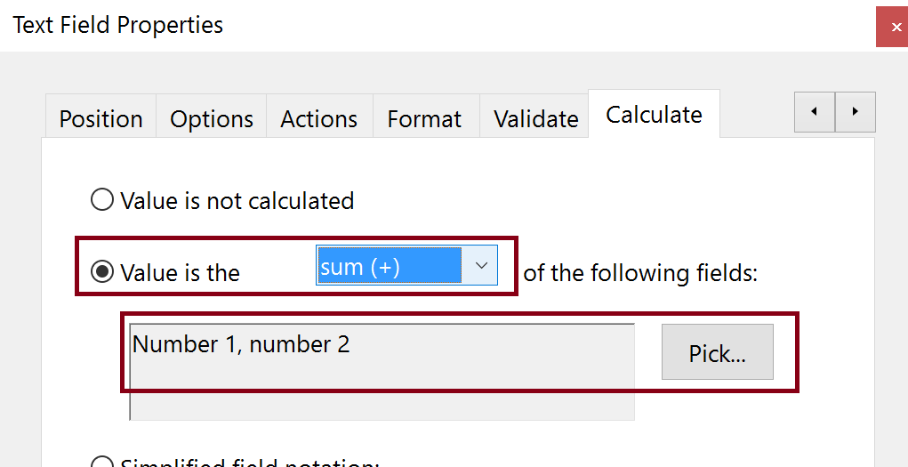
Calculations
Create Text Field
Format Tab in Properties
Set Format Category to Number
Choose Number Options
Calculate Tab
Create Calculation (Value is the…)
Add fields to be included in the calculation
Options Tab
Set Alignment

Slide 30
Questions?

Slide 31
Contacts and Resources
U.S. Department of the Interior
Siddhartha Sharma, Section 508 Program Manager: Siddhartha_Sharma@ios.doi.gov
Regina Wendling, Government Information Specialist: Regina_Wendling@ios.doi.gov
Adobe
Robert Haverty: Haverty@Adobe.com
Resources
Adobe PDF Training Records
https://experienceleague.adobe.com/docs/document-cloud-learn/acrobat-learning/advanced-tasks/accessibility-series/accessibility-series.html?
Adobe Accessibility Web site
www.adobe.com/accessibility
Adobe Blogs
https://blog.adobe.com/
Standards
ISO 32000 (free)
ISO 14289 (PDF/UA) (purchase)

